Slide 1
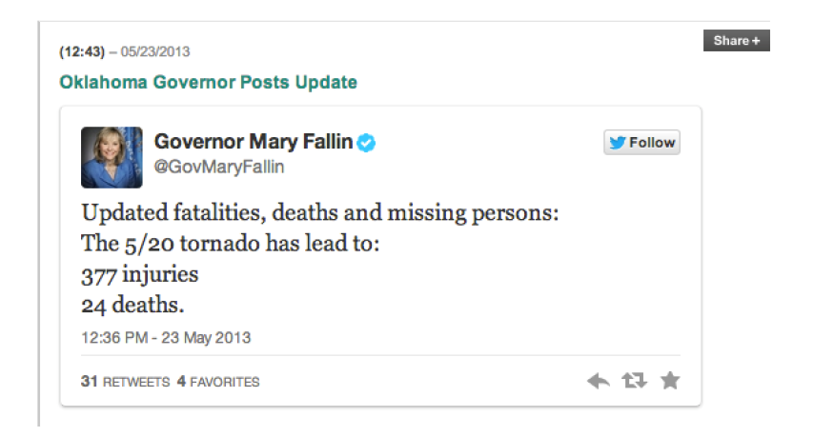
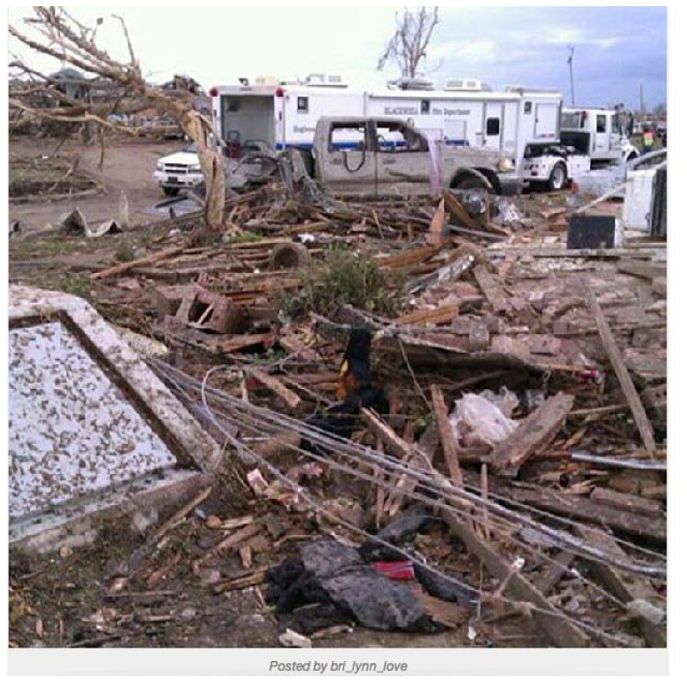
Oklahoma Governor’s Twitter Page

Slide 2
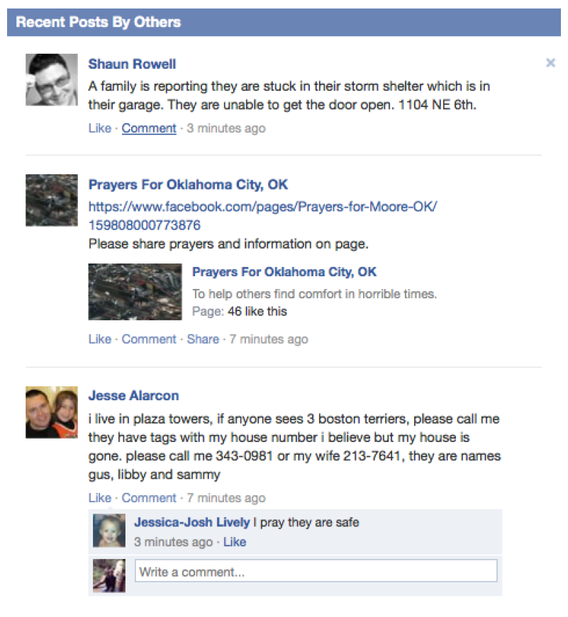
City of Moore’s Facebook Page

Slide 3
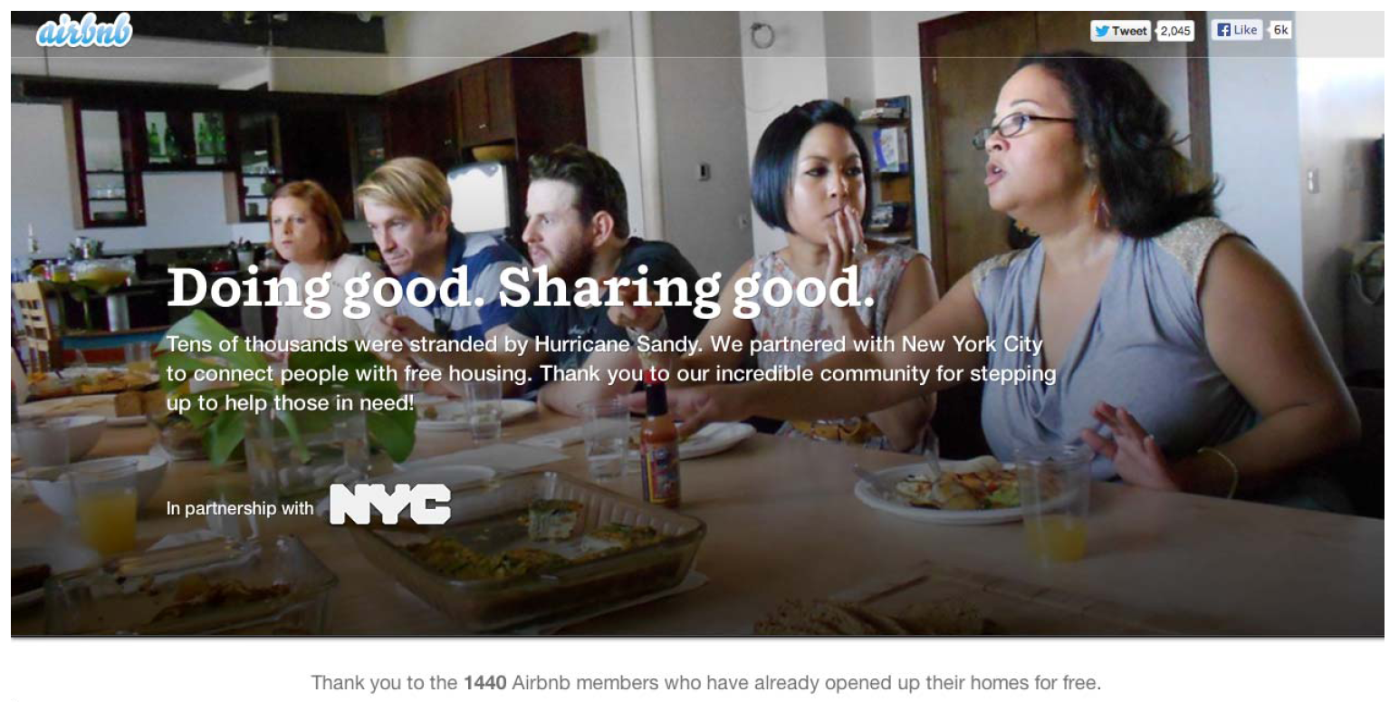
AirBnb Page for Hurricane Sandy

